Slide 1
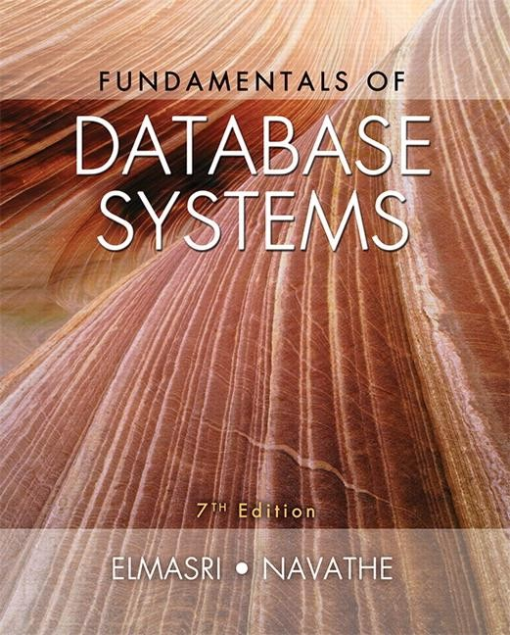
Copyright © 2016 Ramez Elmasri and Shamkant B. Navathe

Slide 2
CHAPTER 2
Database System Concepts and Architecture
Slide 1- 2

Slide 3
Outline
Data Models and Their Categories
History of Data Models
Schemas, Instances, and States
Three-Schema Architecture
Data Independence
DBMS Languages
Database System Utilities and Tools
Slide 2- 3

Slide 4
Data Models and Database Schemas
Slide 1- 2

Slide 5
Data Models
Data Model:
A set of concepts to describe the structure of a database, the operations for manipulating these structures, and certain constraints that the database should obey.
Data Model Structure and Constraints:
Constructs are used to define the database structure
Constructs typically include elements (and their data types) as well as groups of elements (e.g. entity, record, table), and relationships among such groups
Constraints specify some restrictions on valid data; these
constraints must be enforced at all times

Slide 6
Data Models (continued)
Data Model Operations:
These operations are used for specifying database retrievals and updates by referring to the constructs of the data model.
Operations on the data model may include basic model operations (e.g. generic insert, delete, update) and user-defined operations (e.g. compute_student_gpa, update_inventory)

Slide 7
Categories of Data Models
Conceptual (high-level, semantic) data models:
Provide concepts that are close to the way many users
perceive data.
(Also called entity-based or object-based data models.)
Physical (low-level, internal) data models:
Provide concepts that describe details of how data is stored in the computer. These are usually specified in an ad-hoc manner through DBMS design and administration manuals
Describe how data is stored as files in the computer
Example: Access path: Structure that makes the search for particular database records efficient
Cospyryighst ©t2e01m6 Rasme.z Elmasri and Shamkant B. Navathe
Slide 2- 6

Slide 8
Categories of Data Models
Implementation (representational) data models:
Provide concepts that fall between the above two, used by many commercial DBMS implementations (e.g. relational data models used in many commercial systems).
Self-Describing Data Models:
Combine the description of data with the data values. Examples include XML, key-value stores and some NOSQL
Cospyryighst ©t2e01m6 Rasme.z Elmasri and Shamkant B. Navathe
Slide 2- 6

Slide 9
Schemas versus Instances
Database Schema:
The description of a database.
Includes descriptions of the database structure, data types, and the constraints on the database.
Schema Diagram:
An illustrative display of (most aspects of) a database schema.
Schema Construct:
A component of the schema or an object within the schema, e.g., STUDENT, COURSE.

Slide 10
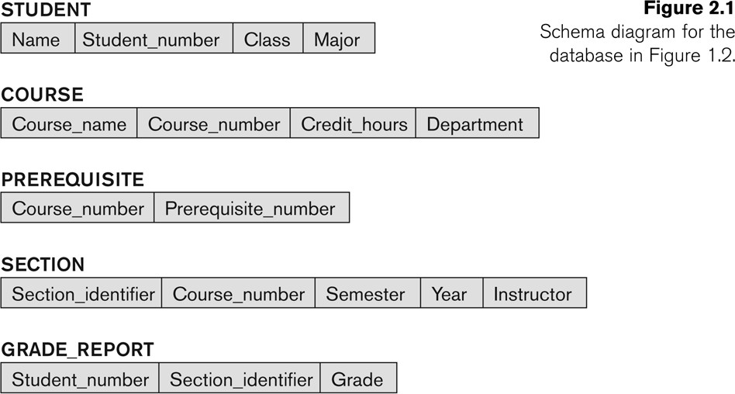
Example of a Database Schema

Slide 11
Schemas versus Instances
Database State:
The actual data stored in a database at a particular moment in time. This includes the collection of all the data in the database.
Also called database instance (or occurrence or snapshot).
The term instance is also applied to individual database components, e.g. record instance, table instance, entity instance

Slide 12
Database Schema vs. Database State
Database State:
Refers to the content of a database at a moment in time.
Initial Database State:
Refers to the database state when it is initially loaded into the system.
Valid State:
A state that satisfies the structure and constraints of the database.

Slide 13
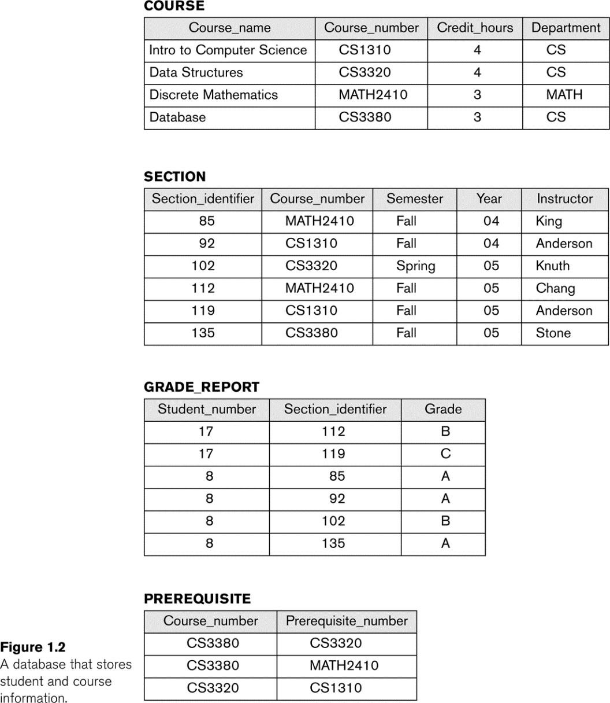
Example of a database state

Slide 14
Database Schema
vs. Database State (continued)
Distinction
The database schema changes very infrequently.
The database state changes every time the database is updated.
Schema is also called intension.
State is also called extension.

Slide 15
Database Architecture
Slide 1- 2

Slide 16
Three-Schema Architecture
Proposed to support DBMS characteristics of:
Program-data independence.
Support of multiple views of the data.
Not explicitly used in commercial DBMS products, but has been useful in explaining database system organization

Slide 17
Three-Schema Architecture
Defines DBMS schemas at three levels:
Internal schema at the internal level to describe physical storage structures and access paths (e.g indexes).
Typically uses a physical data model.
Conceptual schema at the conceptual level to describe the structure and constraints for the whole database for a community of users.
Uses a conceptual or an implementation data model.
External schemas at the external level to describe the
various user views.
Usually uses the same data model as the conceptual schema.

Slide 18
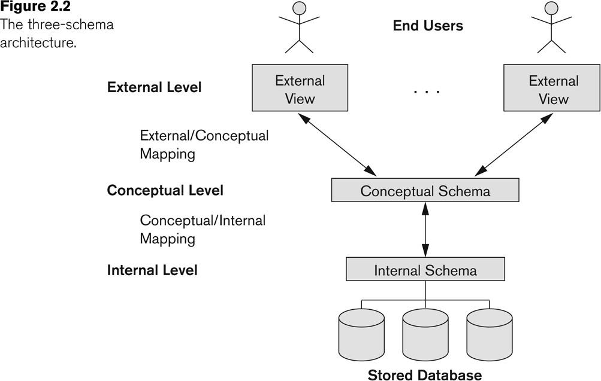
The three-schema architecture

Slide 19
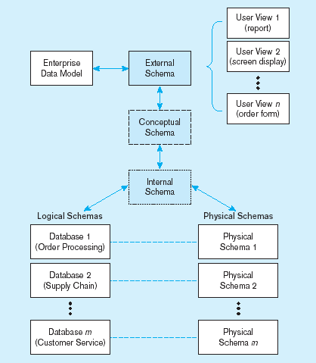
Figure 2-7 Three-schema architecture
Different people have different views of the database…these are the external schema
The internal schema is the underlying design and implementation

Slide 20
Data Independence
Logical Data Independence:
The capacity to change the conceptual schema without having to change the external schemas and their associated application programs.
Physical Data Independence:
The capacity to change the internal schema without having to change the conceptual schema.
For example, the internal schema may be changed when certain file structures are reorganized or new indexes are created to improve database performance

Slide 21
DBMS Languages
Slide 1- 2

Slide 22
DBMS Languages
Data Definition Language (DDL):
Used by the DBA and database designers to specify the conceptual schema of a database.
In many DBMSs, the DDL is also used to define internal and external schemas (views).
In some DBMSs, separate storage definition language (SDL) and view definition language (VDL) are used to define internal and external schemas.
SDL is typically realized via DBMS commands provided to the DBA and database designers

Slide 23
DBMS Languages
Data Manipulation Language (DML)
High-Level or Non-procedural Languages: These include the relational language SQL
May be used in a standalone way or may be
embedded in a programming language
Low Level or Procedural Languages:
These must be embedded in a programming
language

Slide 24
DBMS Languages
Data Manipulation Language (DML):
Used to specify database retrievals and updates
DML commands (data sublanguage) can be embedded in a general-purpose programming language (host language), such as COBOL, C, C++, or Java.
A library of functions can also be provided to access the DBMS from a programming language
Alternatively, stand-alone DML commands can be applied directly (called a query language).

Slide 25
DBMS Components and Tools
Slide 1- 2

Slide 26
Database System Utilities
To perform certain functions such as:
Loading data stored in files into a database. Includes data conversion tools.
Backing up the database periodically on tape.
Reorganizing database file structures.
Performance monitoring utilities.
Report generation utilities.
Other functions, such as sorting, user monitoring, data compression, etc.

Slide 27
Chapter Summary
Data Models and Their Categories
Schemas, Instances, and States
Three-Schema Architecture
Data Independence
DBMS Languages.
Database System Utilities and Tools
Copyright © 2016 Ramez Elmasri and Shamkant B. Navathe
Slide 2- 53

